Slide 1
Presentation Title
Name(s) & Affiliation(s) of Author(s)

Slide 2
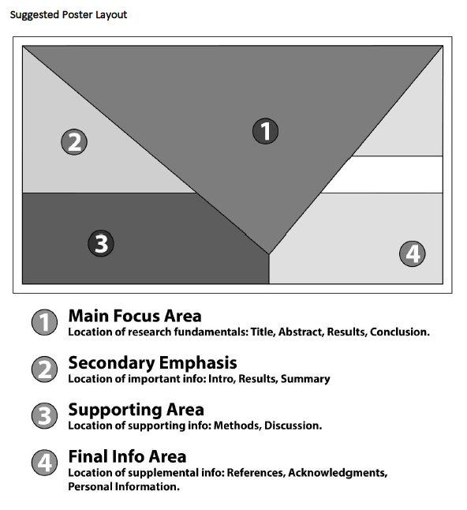
Presentation Content: Good Practice
When organizing information in the slides, please adhere to the rule of thirds.
Please do not remove ICRCC logo from ANY slide.

Slide 3
Contact Information
Use the final slide for full contact information: where they can reach you, where you work, your profession, etc.

