Slide 1
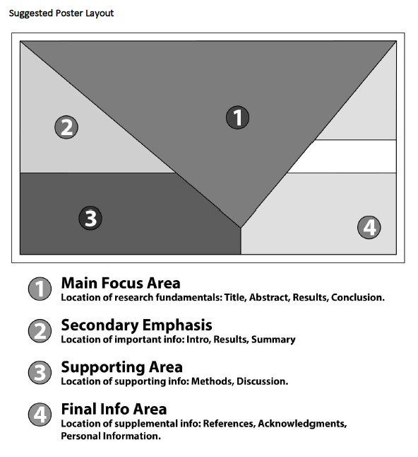

Poster Preparation Guidelines
Size: 48” x 36” (horizontal)
Words and Images:
  Limit use of words and incorporate visuals. Feel free to provide a 1-2 page handout that can use more words.
Visual Design:
  Organize information on the poster by following the “rule of thirds.”

Slide 2
Feel free to use the following slide as a template to prepare your poster . . .

Slide 3

Place Title of Poster and Names/Affiliations of Authors here
Problem & Rationale
Discussion
Conclusions
Implications
Future Directions
Attention Catcher &
Summary of Results
(include visual to draw observer in to learn more…)
Research Question(s) and/or Hypothesis(es)
Theoretical Grounding
References
Methods
Logo for your institutional affiliation(s) (optional)

